Slide 1
Cloud & Serverless Computing
Home Assignment-4
2100032467
U. ASHITHA

Slide 2
Converting Speech to text
Using AWS Serverless Services Amazon Transcribe & S3

Slide 3
Objective
Converting speech to text of audio file using Amazon Transcribe With integration of S3

Slide 4
Description
In this presentation, we delve into the transformative capabilities of AWS Transcribe, Amazon's powerful speech-to-text service. Join us as we explore how businesses can leverage AWS Transcribe to effortlessly convert spoken language into written text, unlocking valuable insights from audio data. We'll cover the features, benefits, and practical applications of AWS Transcribe, showcasing its role in streamlining data management and analysis workflows. Whether you're a technology enthusiast, business professional, or data scientist, this presentation offers valuable insights into the potential of AWS Transcribe to drive innovation and efficiency in your organization. Don't miss out on this opportunity to discover the power of AWS Transcribe and stay ahead in the rapidly evolving world of cloud computing.

Slide 5
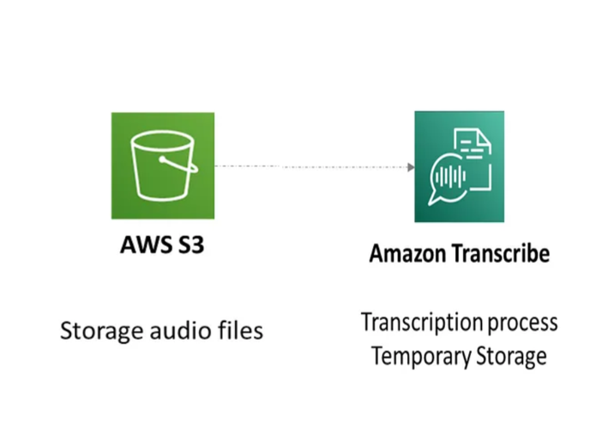
Custom Architecture Design

Slide 6
List of serverless services utilized
Amazon Transcribe
Simple Storage Service

Slide 7
Detailed procedural steps
Upload Audio File to S3 Bucket: Begin by uploading the audio file that you want to transcribe to an Amazon S3 bucket. You can use the AWS Management Console, AWS CLI (Command Line Interface), or AWS SDKs (Software Development Kits) to upload the file.
Configure S3 Bucket Permissions: Ensure that the S3 bucket has the necessary permissions to allow AWS Transcribe to access the audio file for transcription. You may need to set up IAM roles and policies to grant Transcribe the required permissions.
Create a Transcription Job: Navigate to the AWS Transcribe service in the AWS Management Console. Select "Create transcription job" and provide details such as the name of the job, the language of the audio content, the location of the audio file in the S3 bucket, and any additional settings like vocabulary customization or speaker identification.

Slide 8
Monitor Transcription Job: Once the transcription job is created, you can monitor its progress in the Transcribe console. Transcribe will automatically process the audio file and generate the corresponding text transcription.
Retrieve Transcription Results: After the transcription job is complete, you can retrieve the transcribed text from the output generated by AWS Transcribe. This text can be downloaded from the Transcribe console or accessed programmatically using AWS SDKs or APIs.
Optional: Configure Output Settings: AWS Transcribe allows you to configure various output settings, such as specifying the format of the transcribed text (e.g., JSON, plain text), enabling timestamps, and selecting the location to store the transcription output. You can customize these settings based on your requirements.
Review and Refine Transcription: Once you have the transcribed text, review it for accuracy and make any necessary edits or refinements. While AWS Transcribe is highly accurate, it may occasionally misinterpret certain words or phrases, especially in noisy or complex audio environments.
Integrate Transcription Output: Finally, integrate the transcribed text into your desired applications or workflows. You can use the text for various purposes, such as generating subtitles for videos, indexing audio content for search, or extracting insights from spoken data for analytics.

Slide 9
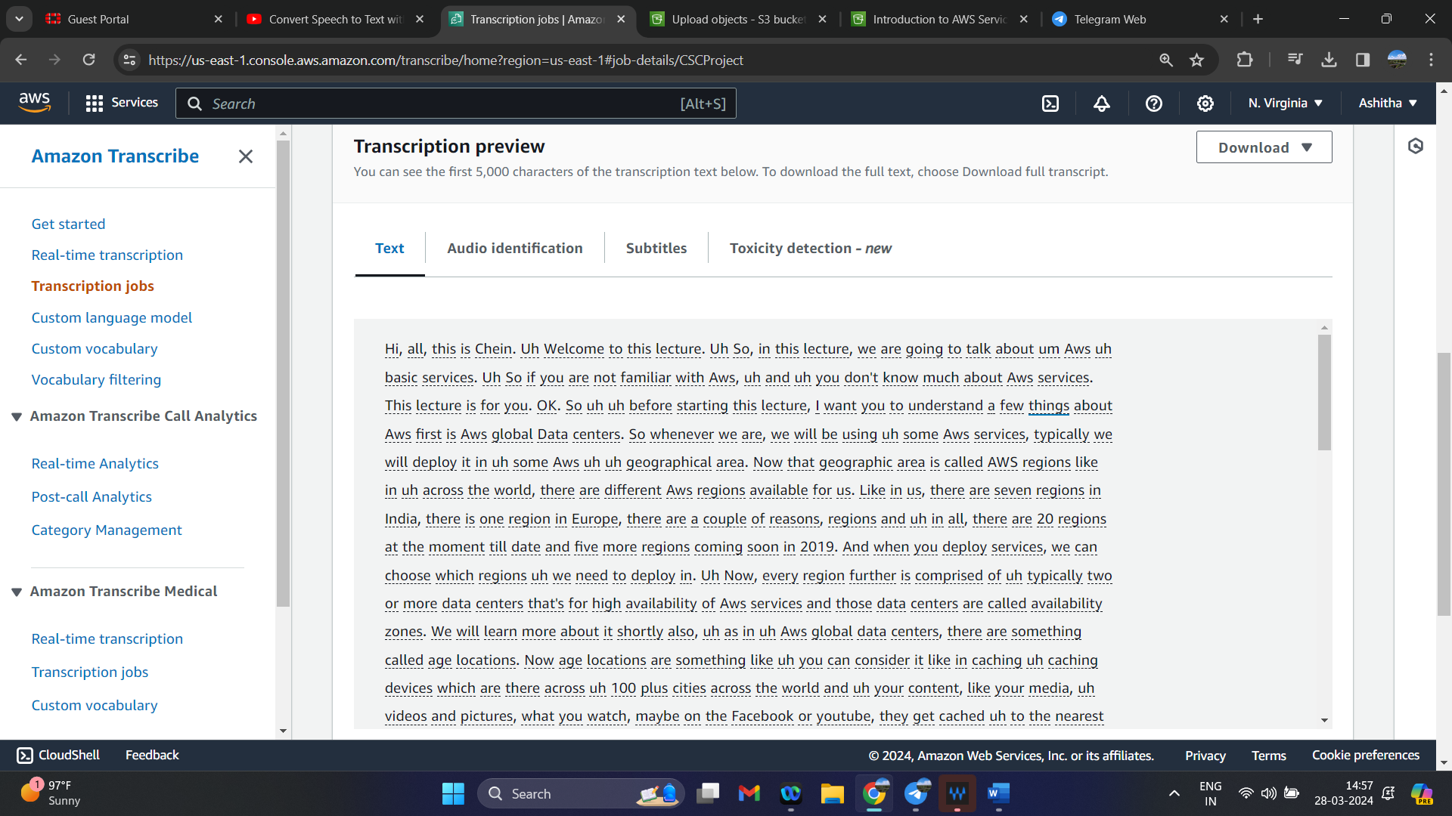
Output

Slide 10
Conclusion
AWS Transcribe empowers organizations to unlock the value of their audio data by providing accurate and scalable speech-to-text conversion capabilities. Whether it's improving accessibility, enhancing productivity, or gaining deeper insights from audio content, Transcribe offers a versatile solution that meets the needs of modern businesses. By harnessing the power of AWS Transcribe, organizations can transform the way they interact with speech data and drive innovation across their operations.

Slide 11
Links to the LinkedIn Article, YouTube Video, GitHub repo.
LinkedIn Article- https://www.linkedin.com/posts/ashitha-uppala-573898226_cloud-activity-7179621822290620416-ROdS?utm_source=share&utm_medium=member_desktop
You Tube Video- https://youtu.be/JYZ_AeIxjrg

